Slide 1
FHIR Guided Hands-on for Payors
Lloyd McKenzie
Oct. 18, 2017

Slide 2

Who am I?
Name: Lloyd McKenzie
Company: Gevity
Background:
One of FHIR’s 3 initial editors
Co-chair FMG, FHIR-I and MnM
HL7 Fellow
Heavily involved in HL7 and healthcare exchange for last 17 years (v2, v3, CDA, etc.)
lmckenzie@gevityinc.com

Slide 3
This presentation
Can be downloaded here:
https://github.com/FHIR/documents/blob/master/presentations/2017-10%20Payors/Guided%20FHIR.pptx
Use “anonymous” and email address to logon
Is licensed for use under the Creative Commons, specifically:
Creative Commons Attribution 3.0 Unported License
(Do with it as you wish, so long as you give credit)

Slide 4
Attendees
What is your role?
HL7 (v2/v3/CDA) background?
How familiar are you with FHIR?
What are the interoperability “pain points” that impact you the most?
What is the one thing that will make today most valuable for you?

Slide 5
Tutorial Objectives
You should know
What makes FHIR different
What resources are and how they’re used
How to read the FHIR spec and understand resources
FHIR’s interoperability paradigms (and where to use)
Where FHIR can fit in the architectural stack & architecture considerations
How to query FHIR data
What resources exist to support implementation
Notes:
Have < 3 hours so focus is more on “identifying considerations” than deeply exploring options

Slide 6
Level Setting
Today will not examine much of the “why” of FHIR, just the “what” and the “how”
If you’re interested in the “why” or how FHIR relates to v2/v3/CDA, additional training is available – or talk to one of the payors in the room who have been participating at HL7

Slide 7
Agenda
Morning
How is FHIR different?
What are resources?
Navigating the FHIR spec
FHIR’s paradigms
Afternoon
RESTful queries
Implementation supports
Architectural approaches

Slide 8
What is FHIR?
And how is it different?

Slide 9
The acronym
F – Fast (to design & to implement)
Relative – No technology can make integration as fast as we’d like
H – Healthcare
That’s why we’re here
I – Interoperable
Ditto
R – Resources
Building blocks – more on these to follow

Slide 10
FHIR – Key differences
Focus on Implementers
Target support for common scenarios
Leverage cross-industry web technologies
Require human readability as base level of interoperability
Make content freely available
Support multiple paradigms & architectures
Demonstrate best practice governance
Notes:
We don’t actually have a formal manifesto, but these are the principles we adhere to.

Slide 11
Implementer Focus
Specification is written for one target audience: implementers (that’s not just programmers)
Rationale, modeling approaches, etc. kept elsewhere
Multiple reference implementations from day 1
Publicly available test servers
Starter APIs published with spec
C#, Java, Pascal, Swift, more coming
Connectathons to verify specification approaches
Instances you can read and understand ☺
Lots of examples (and they’re valid too)
using HL7.Fhir.Instance.Model;
using HL7.Fhir.Instance.Parsers;
using HL7.Fhir.Instance.Support;
XmlReader xr = XmlReader.Create(
new StreamRead
IFhirReader r = new XmlFhirReader
// JsonTextReader jr = new JsonTe
// new StreamRead
// IFhirReader r = new JsonFhirRe
ErrorList errors = new ErrorList(
LabReport rep = (LabReport)Resour
Assert.IsTrue(errors.Count() == 0
Notes:
Spec is driven by people who write code
Numerous pieces have been changed because of experience with what worked when trying to implement
Even have a test workbench for RESTful servers

Slide 12
Support “Common” Scenarios
80%
Inclusion of content in core specification is based on “80%” rule
Only include data elements we are confident that most (~80%) of normal implementations using that resource will make use of
Other content in extensions (more on this later)
Easy to say, governance challenge to achieve
Resources are simple and easy to understand & use
Notes:
Design by constraint failed – years to develop, what was produced required yet more design to be implementable and after that might not be interoperable
How to determine the 80%? Look to existing specs – v2, v3, CDA templates, OpenEHR, jurisdictional projects, what implementations we’ve seen
If not sure, err on the side of “not in for now”
Note: not 80% of instances, 80% of implementations
Challenges with “raising the bar”
What happens when there aren’t many/any implementations?

Slide 13
Example – ISO AD type
isNotOrdered, updateMode, flavorId, nullFlavor, controlAct root & extension, validTime low and high, useable period (GTS – no room on the slide), use
home, primary home, vacation home, workplace, direct, public, bad, physical, postal, temporary, alphabetic, ideographic, syllabic, search, soundex, phonetic
0..* parts, each with:
value, code, code system, code system name, code system version, language, type:
address line, additional locator, unit identifier, unit designator, delivery address line, delivery installation type, delivery installation area, delivery installation qualifier, delivery mode, delivery mode identifier, street address line, building number, building number numeric, building number suffix, street name, street name base, street type, direction, intersection, care of, census tract, country, county or parish, municipality, delimiter, post box, precinct, state or province, postal code, delivery point identifier
Notes:
How many of your systems have user interfaces that support even ¼ of this?

Slide 14
Example – FHIR Address
isNotOrdered, updateMode, flavorId, nullFlavor, controlAct root & extension, validTime low and high, useable period (low, high) (GTS – no room on the slide), use
home, primary home, vacation home, workplace, direct, public, bad, physicalvisit, postal, temporary, alphabetic, ideographic, syllabic, search, soundex, phonetic, old
0..* parts, each with:text
value, code, code system, code system name, code system version, language, type:
address line, additional locator, unit identifier, unit designator, delivery address line, delivery installation type, delivery installation area, delivery installation qualifier, delivery mode, delivery mode identifier, street address line, building number, building number numeric, building number suffix, street name, street name base, street type, direction, intersection, care of, census tract, country, county or parish, municipalitycity, delimiter, post box, precinct, state or province, postalCode, delivery point identifier
Notes:
This is what happens when you apply the 80% . . .

Slide 15
Won’t extensions break interoperability?
The 80% + narrative helps provide “base” interoperability
For “robust” interoperability
Profile – constrains structure
Conformance – constrains behavior
Needed to claim “I’m FHIR conformant”
Notes:
1000s of extensions, everyone supports different things, don’t know what anyone does
Not everyone will support the 80%, but most will
“What most systems support” (and thus what you should probably support too) encourages base interoperability
Human readable fallback
Profile – what elements are supported, registries available
Conformance – REST operations, documents, messages, services

Slide 16
Web technologies
Instances shared using XML & JSON
Web calls work the same way they do for Google & Twitter
Rely on HTTPS, OAuth, etc. for security functions
Benefits
Cross-Industry standards
Well supported by tools
Understood by developers
http://...
Notes:
We try very hard to *not* invent stuff that exists elsewhere unless it’s really broken or totally unaligned with the FHIR principles.

Slide 17

Human Readable
Clinical Documents has both narrative and data
The data / narrative dynamic exists throughout the process
In FHIR, every resource can (should) have a human-readable expression
Can be direct rendering or human entered
Notes:
Even when you think your target will understand all the encoded data, reality is data often gets shared beyond the originally intended context
Allow for exceptions for things like automated device readings, etc.

Slide 18
Freely available
Unencumbered – free for use, no membership required
http://hl7.org/fhir + other versions
Licensed under CC0: True public domain
Any use is allowed
HL7 enforces the trademark protection
Business model:
If you want to vote, you need to pay
Notes:
Was a bigger deal before HL7 decided to open up all IP
Link to full legal text towards bottom of FHIR home page

Slide 19
Paradigms
FHIR supports 4 interoperability paradigms
REST – Lightweight, leverages web stack
Documents – Long-term persistence
Messages – Request/response paradigm
Services – other SOA-based interfaces
Regardless of approach, content stays the same
Can leverage same models, same profiles everywhere

Slide 20
Review
What are FHIR’s 7 “Key Differences”

Slide 21
FHIR Resources

Slide 22
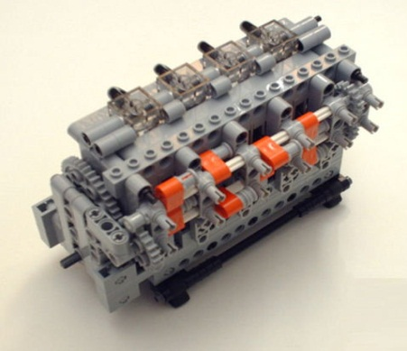
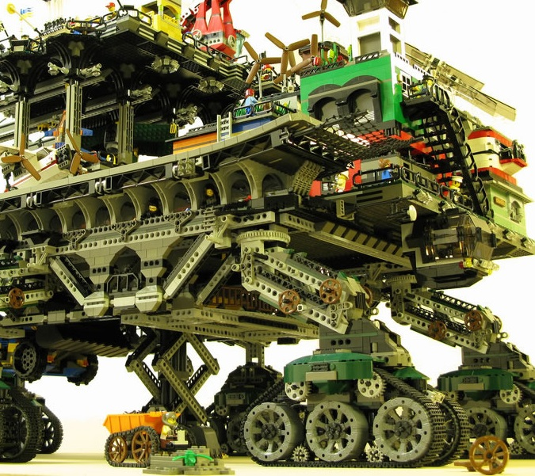

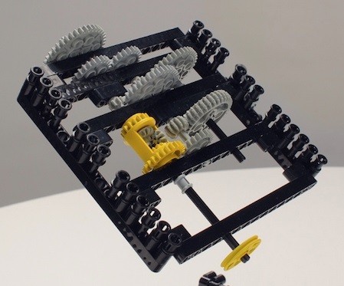
FHIR solutions
Resources
Extensions
Solution
+
=
Notes:
Resources are building blocks, but useful in their own right
Extensions supplement what resource doesn’t cover
Solutions can be simple or complex

Slide 23


Resources
“Resources” are:
Small logically discrete units of exchange
Defined behavior and meaning
Known identity / location
Smallest unit of transaction
“of interest” to healthcare
V2: Sort of like Segments
V3: Sort of like CMETs

Slide 24
What’s a Resource?
Examples
Non-examples
Administrative
Patient, Practitioner, Organization, Location, Coverage, Invoice
Clinical Concepts
Allergy, Condition, Family History, Care Plan
Infrastructure
Document, Message, Profile, Conformance
Gender
Too small
Electronic Health Record
Too big
Blood Pressure
Too specific
Intervention
Too broad
100-150 total - ever
Notes:
And few systems will ever see more than 40-50

Slide 25
Structure of a Resource
Resource
Narrative
Metadata
Elements
Extensions
Extensions

Slide 26
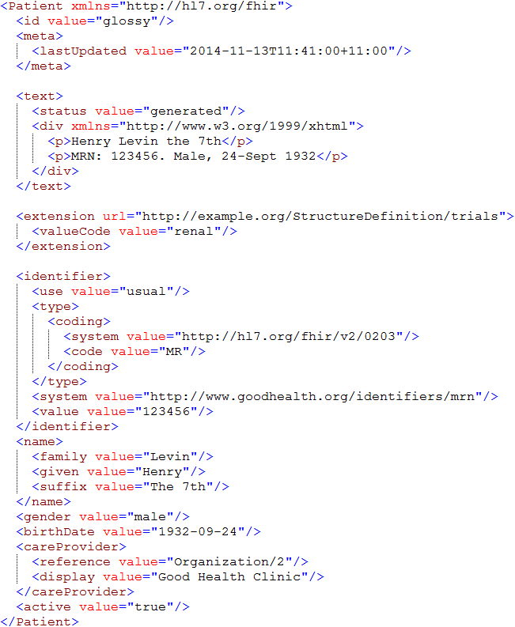
Identity & Metadata
Human Readable Summary
Extension with reference to its definition
Standard Data Content:
MRN
Name
Gender
Date of Birth
Provider

Slide 27
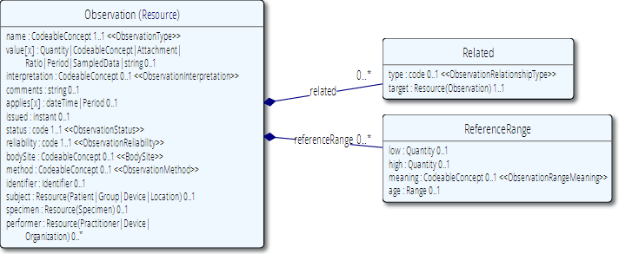
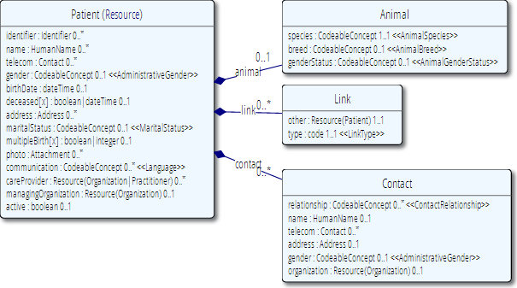
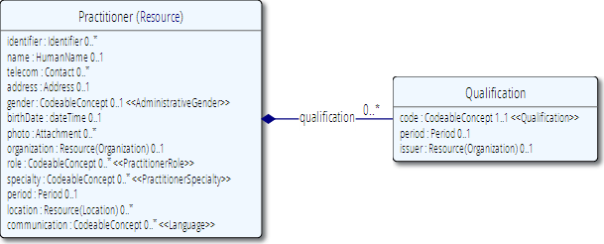
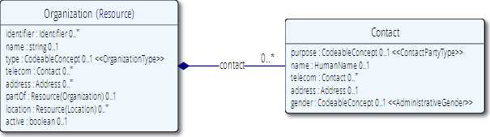
Network
subject
performer
organization

Slide 28
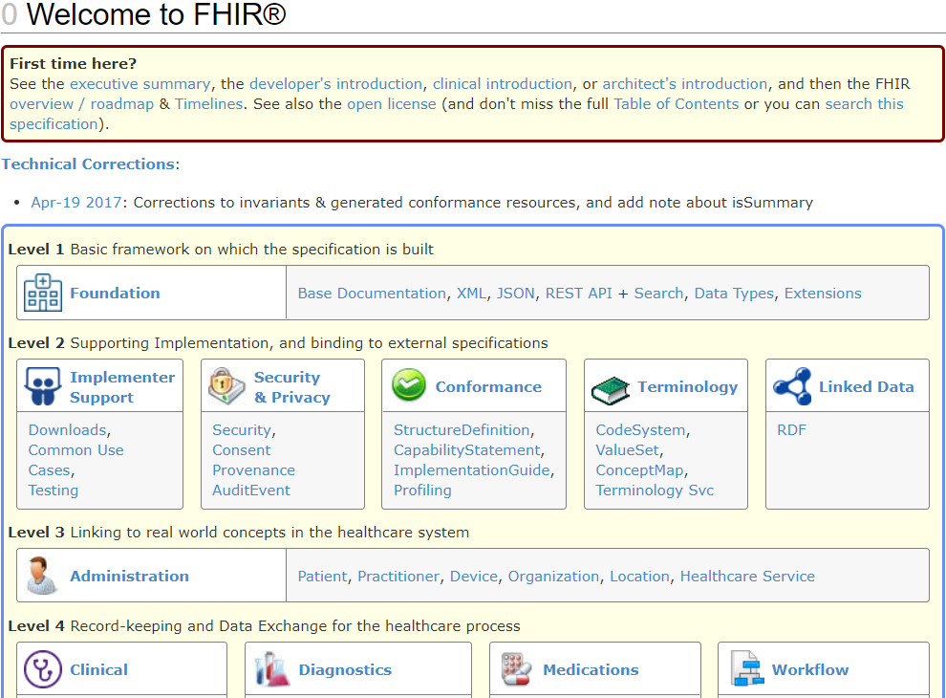
Browsing the site
Notes:
Jump to the spec. Jump around. Finish ~10am

Slide 29
Browsing the site
REST API
Data Types
XML & JSON
Codes / Terminologies
Resource List

Slide 30
The FHIR distribution
Under Implementation-Support-Downloads:
The XSD schema’s / schematrons
The Java / C# / Delphi zips (model, serializers, parsers, etc, both code & binary)
All xml + json examples
Full spec for offline reading (always have your FHIR with you)

Slide 31
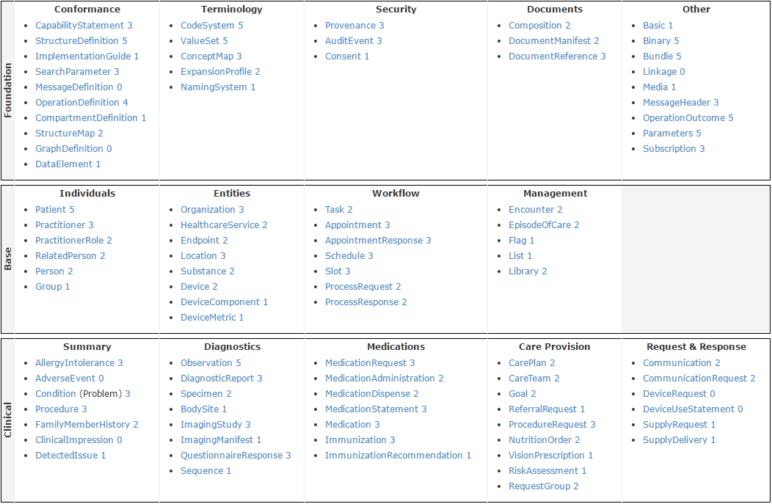
STU 3 Resource List

Slide 32
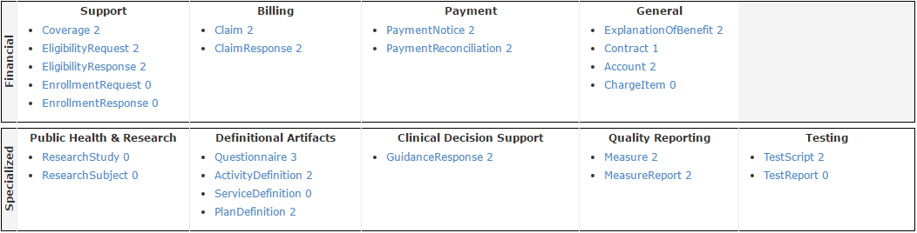
STU 3 Resource List

Slide 33
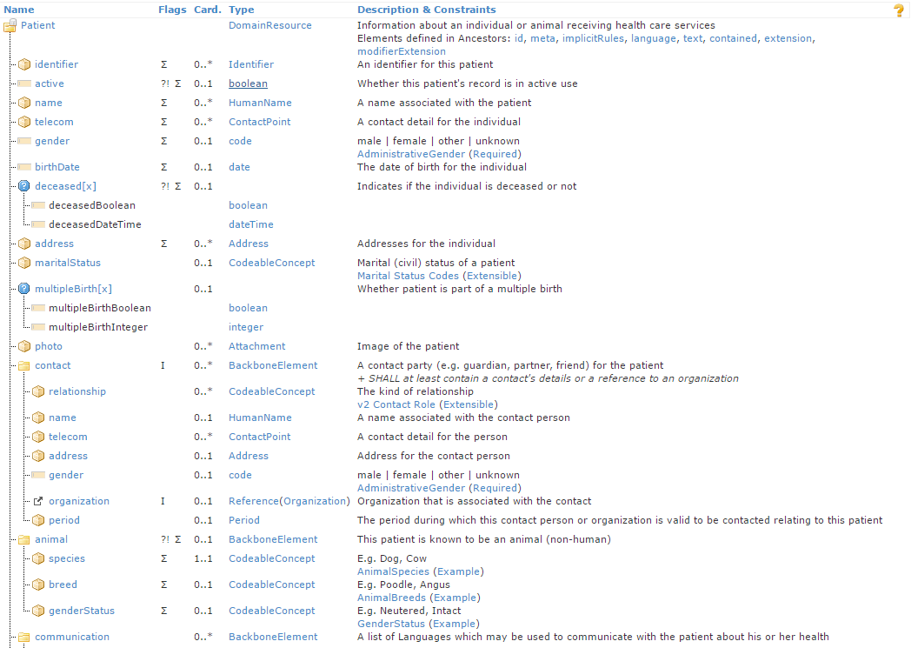
Resource Definitions

Slide 34
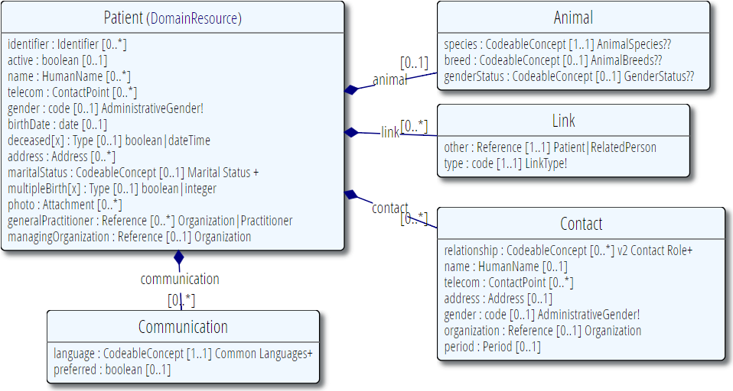
Resource Definitions

Slide 35
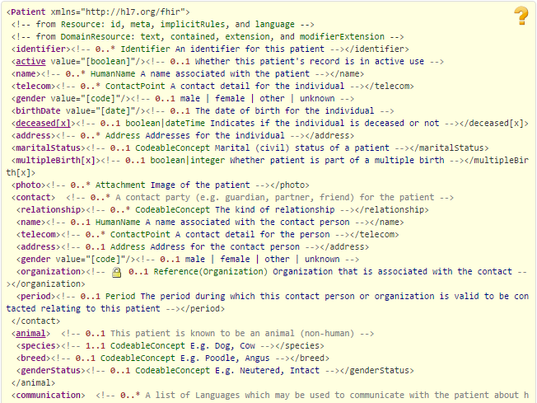
Resource Definitions

Slide 36
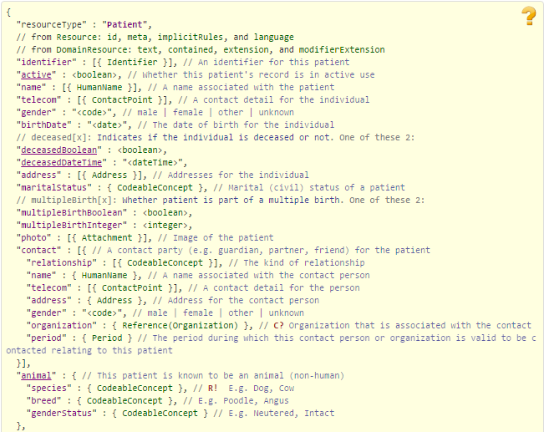
Resource Definitions

Slide 37
What Paradigm

Slide 38
Paradigms
FHIR supports 4 interoperability paradigms
REST
Documents
Messages
Services
What should you use when?
Notes:
Temperature check – how many people feel they’ve got a good handle on the paradigms and when they’d use them vs. not. (This isn’t really FHIR-specific)

Slide 39
REST
Simple, out-of-the-box interoperability
Leverage HTTP: GET, POST, etc.
Pre-defined operations
Create, Read, Update, Delete
Also: Read Version, Search (resource/type/server), History (resource/type/server), Capabilities, Patch, Batch & Transaction
Rest
Notes:
Review

Slide 40
FHIR Resource URLs
Template | Description | Example | Operations
[base] | Server URL | http://fhir.com | GET, POST
[base]/[type] | Collection Manager | http://fhir.com/Patient | GET, POST
[base]/[type]/[id] | URL for a resource | http://fhir.com/Patient /23 | GET, PUT, DELETE, PATCH
[base]/[type]/[id]/_history/[vid] | Past version | http://fhir.com/Patient/23/_history/2 | GET
[base]/([type]/([id]/)?)?$[name] | Operation (server action) | http://fhir.com/Patient /23/$everything | GET, POST
Notes:
URL (http://myhospital.org/) you are invoking in first column, and operations at right
OPTIONS - Return available HTTP methods and other options

Slide 41
When to use REST?
Want low coupling between systems
In theory, very little up-front negotiation required
Small, light-weight exchanges
Focus is CRUD operations
Also for publish/subscribe
Client-driven client-server orchestration
Server endpoint has fixed location
Well-suited for Mobile, PHR, Registries
Rest
Notes:
Not talking about REST in general, but rather FHIR’s implementation of REST

Slide 42
When to avoid REST?
Complex or server-driven orchestration
Order of operations matters (e.g. complex decision support)
Unit of work != resource
“Transaction” may be an option
No natural “server” or no fixed network location
Lack of trust in the client for contextual audit, etc.
Rest
Notes:
Todo: more specifics from Grahame.

Slide 43
Documents
Similar to CDA
Collection of resources bound together
Root is a “Composition” resource
Just like CDA header
Sent as a Bundle resource
One context
Can be signed, authenticated, etc.
Documents

Slide 44
Documents – are bundles
Composition Resource
<Bundle>
<entry>
<resource>
<Composition />
</resource>
</entry>
<entry>
<resource>
<Observation />
</resource>
</entry>
<entry>
<resource>
<Device />
</resource>
</entry>
<entry>
<resource>
<List/>
</resource>
</entry>
<entry>
<resource>
<Condition/>
<resource>
</entry>
</Bundle>
Metadata
Attester
Section
Section
Section
Observation Resource
Device Resource
List Resource
Condition Resource
Notes:
A Document, no matter how nested, is flattened to a list of entries, the Document’s header being the first.
The document header (and any other the other resources) refer to each other using normal references to reflect the document’s nesting.
Of course, there may be a digital signature (on the whole Bundle) to attest to the content of the document.

Slide 45
When to use Documents?
Focus is on persistence
No workflow involved
other than post/retrieve document
Need tight rules over authenticated content
Want to communicate multiple resources with control over how data is presented
Data spans multiple resources
Documents

Slide 46
When to avoid Documents?
Need for workflow
Request/response, decision support
Data is dynamic
I.e. want view of data now, not at time of authorship
Multiple contributors over time
Resources need to be accessed/manipulated independently
Documents

Slide 47
Messages
Similar to v2 and v3 messaging
Also a collection of resources as a Bundle resource
Allows request/response behavior with bundles for both request and response
Event-driven
E.g. Send lab order, get back result
Can be asynchronous and/or indirect
Messages

Slide 48
Messages – are bundles
MessageHeader Resource
<Bundle>
<entry>
<resource>
<MessageHeader />
</resource>
</entry>
<entry>
<resource>
<Observation />
</resource>
</entry>
<entry>
<resource>
<Device />
</resource>
</entry>
<entry>
<resource>
<Patient/>
</resource>
</entry>
</Bundle>
source
destination
event
Observation Resource
Device Resource
Patient Resource
Notes:
A Message is similar, refers (amongst others) to its author, and contains information about the source, destination and the event that triggered it.
A message contains 1 “data” resource, which is the root of the payload of the message. This is just a normal resource, which in its turn can refer to other related resources.

Slide 49
When to use Messaging?
Request/response workflow
Need to drive behaviors more complex than CRUD on a single resource
E.g. merge, complex queries
Need for asynchronous/indirect exchange
Need to communicate information about many resources but want to minimize exchanges
No “identity” for many resources
Messages

Slide 50
When to avoid Messaging?
Precise control required on how data gets persisted/displayed to humans
Need for lightweight communications
Want to avoid pre-negotiations on behavior
Messages

Slide 51
Service Oriented Architecture (SOA)
Do whatever you like
(based on SOA principles)
Ultra complex workflows
Ultra simple workflows
Individual resources or collections (in Bundles or other formats)
Use HTTP or use something else
Only constraint is that you’re passing around FHIR resources in some shape or manner
Services
Notes:
With REST you have to use HTTP - for SOA, you can use SOAP or whatever infrastructure you lik
Could pass individual data types
Only constraint is data you are passing is valid against FHIR schema

Slide 52
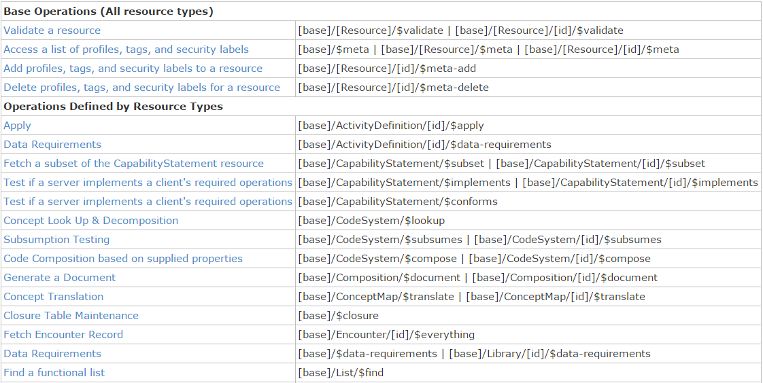
Example services

Slide 53
When to use Services?
All previous paradigms are a type of services interface
Use a custom service when capabilities of other paradigms don’t fit requirement
Operations other than CRUD on a resource (e.g. decision support)
Workflow more complex than simple request/response
Need to mix document persistence with behavior
Services
Notes:
Services make sense when the other options don't work
Rather then request response, you want to send one set of information to A and another to B, and they are going to coordinate with System C for an answer to communicate with B/C to get your answer
Maybe you need to mix behaviors

Slide 54
When not to use services?
When something else will do the job as well
I.e. Don’t define a custom service for something that already naturally is handled by REST, messaging, etc.
Services

Slide 55
Paradigm guidance
No absolutes
Consider a “when to avoid” as a note of caution
Capabilities/architecture of legacy will often drive approach, particularly initially
E.g. If v2 back end, messaging
Architectures will be driven by legacy requirements, architectural preferences, enterprise architecture commitments, etc.

Slide 56
Combining paradigms
No requirement for a system to only support one paradigm
E.g. hospital may be primarily messaging, but use documents for discharge summaries and reports and expose registries and appointments via REST with a few custom services for decision support or specialized workflow
Data (generally) shared easily across paradigm boundaries
Notes:
Consider multiple paradigms when creating instances – don’t want to have to re-craft the narrative because you want to use a resource now in a document instead of a message

Slide 57
Caveats with combining paradigms
If updates come in via document, message or service, RESTful version id still needs to increment
Documents should typically be persisted whole, not reconstituted from parts
Ensures signature validity
Legacy messaging systems may not provide the metadata to easily expose or manipulate discrete resources via REST

Slide 58
Apply it
What paradigm(s) are you like to use in your organization and why?

Slide 59
FHIR Architecture Approaches

Slide 60
Some possible uses
v3
App
v2
FHIR
PHR
FHIR
Broker
Comm.
Interface
FHIR
DB
Notes:
You’re a message broker routing and translating between v2, v3 and FHIR
Your app interfaces with a PHR using FHIR natively
Your application can communicate using FHIR, but your software uses a proprietary RDBMS
Use FHIR as the common language for a Vendor Neutral Archive
…Or a combination….
You might see data as a nested structure of XML, a series of tables with keys, class-diagrams….

Slide 61
Repository model
HIS
LIMS
PACS
SystemX
Gateway
FHIR
FHIR
FHIR
FHIR
FHIR
Vendor Neutral Repository

Slide 62
Beyond exchange
v3
Other
v3
v2
Other
v2
Decision Support
Broker
FHIR
FHIR
Repository
FHIR
X12
Notes:
FHIR can be your shared persistence layer – nice granularity for storage, extensions for handling “extra” stuff easily
FHIR can be the common model for your mapping layer
FHIR can be the logical model used for decision support, both to expose your data to the decision support engine as well as to define rules (work in progress with vMR-CDS and CQI)

Slide 63
Overview of a server
HTTP / REST interface
Encoding/decoding, param validation, syntax validation
Implement service operations as described in spec
Fhir Service
Indexer / Search
Storage
Notes:
-HTTP front end – knows how to encode/decode parameters, valid syntax and parse headers – most likely able to find off the shelf for your language of choice
-FHIR Aware – need something that /patient and /observation mean something different. And what type of operations are permitted.
-Persistent layer – sometimes you put into one, or you have a secondary repository for search. Index layer is important because FHIR defines search paramters – expect case-insensitive and no accents.
If you are querying against quantity and you want it normalized for unit of measures, or diagnoses that handle subsumption testing…this works because FHIR has a defined set of search query.

Slide 64
From wire to store
REST interface
JSON/XML
JSON/XML
JSON/XML
FHIR Parser
FHIR Parser
FHIR Parser
Fhir Service
POCO/POJO
POCO/POJO
POCO/POJO
O-R Map
Serialize
Serialize
Storage
NoSql (Xml/Json)
DBMS
DBMS
Notes:
Data starts at restful interface.
Parser – with reference implentation or your custom parser. Don’t have to do it. Can manipulate JSON/XML directly, but conversion to object model is helpful.
-Plain Old Java Object
-Plain Old CLR Object -- Common Language Runtime is used for .NET
--
Receive in whatever format then map
And parse to your object model and then decided how to persist
3 approaches we have seen
Object relational-map - use a tool, something like hibernate to map form internal model and database tables
NoSQL - couchdb where you are storing JSON/XML directly or trimming to triple store
Relational structure, but you don't break into individual columns, you store as blob in your database and build the index. And this works because you have index repo that does all searching and when you retrieve date you are providing resource, not individual columns. Some systems will store both full and summary in blob so you don't have to create on fly.
--
(object reltFirst scenario is most common for existing databases: you have to map the FHIR structure (as POCO’s) onto your (existing) databases tables. Lot’s of mappings to support our nesting, cardinalities, data types
Second scenario uses the parsers to create POCO’s then use a NoSql driver’s serialization possibilities to store the structure-as-is in NoSql
Third scenario uses POCO’s and DBMS, but instead of mapping FHIR to tables, stores the data as-is into blob storage in a DBMS

Slide 65



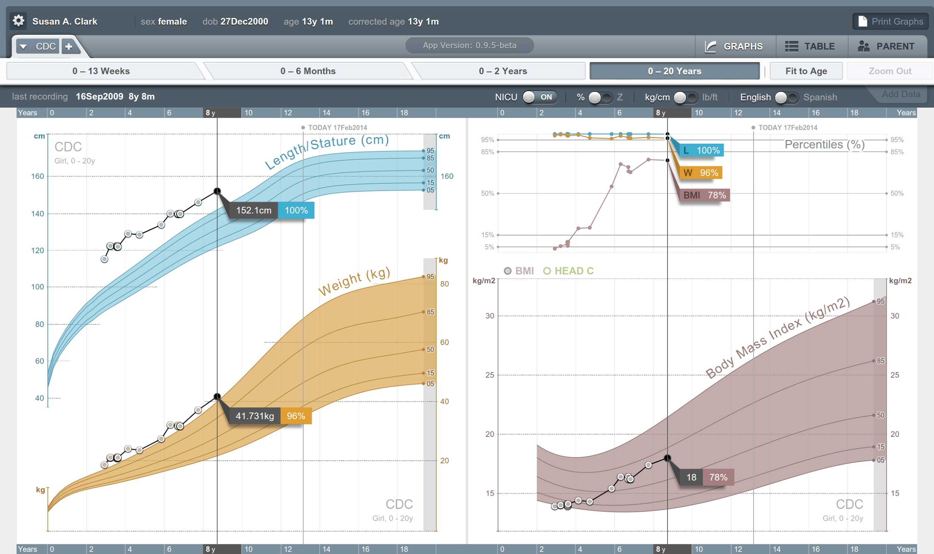


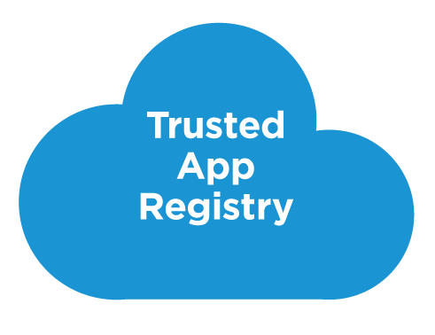



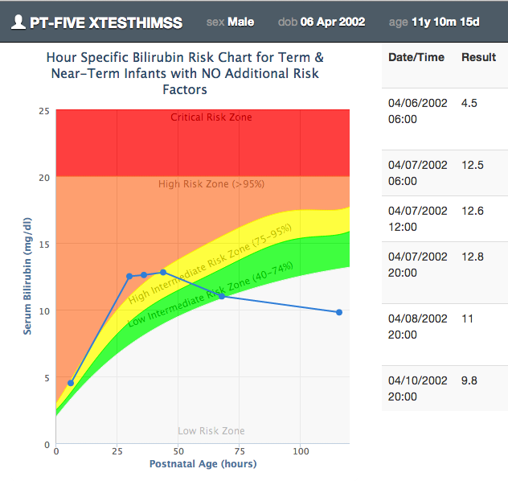







SMART on FHIR
Mobile Apps
Web Apps
OAuth2
REST API
MU-oriented FHIR Data Profiles
Underlying Health IT Systems
Your system here.

Slide 66
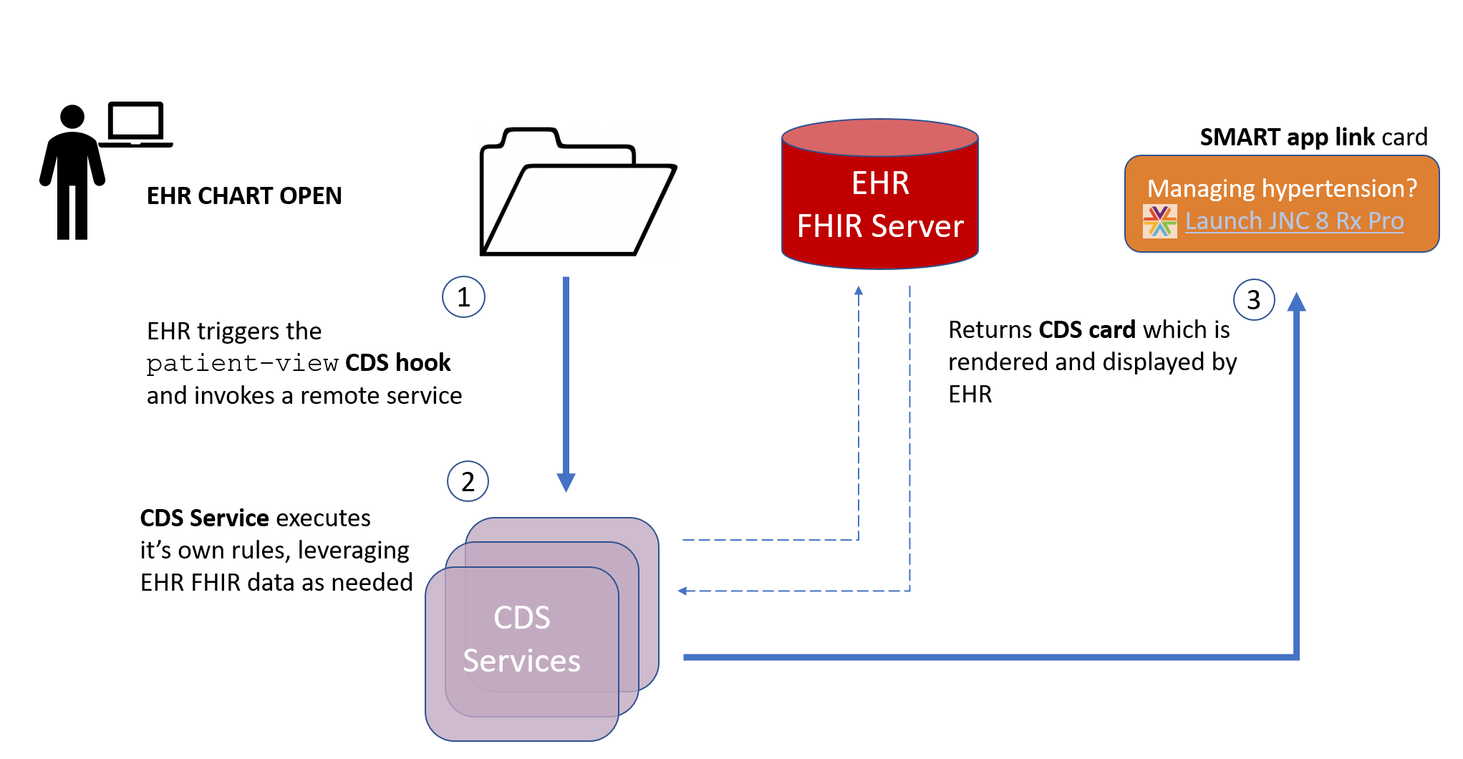
CDS Hooks

Slide 67
Architectures
FHIR makes no assumptions about the architectural design of systems
You can use it for
Light or heavy clients
Central server or peer-to-peer sharing
Push or pull
Query or publish/subscribe
Loosely coupled or tightly coupled environments
With history tracking or without

Slide 68
Bottom Line
FHIR is a set of tools
Defined resources
Extensibility mechanism
Set of standard interfaces
Primary purpose is interoperable data exchange
However, it can be leveraged in many ways
Many we haven’t even thought of yet . . .

Slide 69
Discussion
What paradigms would you use when?
Services
Messages
Documents
REST
Notes:
Graphic: scraped knee?

Slide 70
Querying FHIR
Searches, Queries, Compartments & Validation

Slide 71
Getting “all” patients
https://server.org/fhir/Patient
Always returns a paged Bundle
Use _count to indicate number of results per page
Special case of the “real” search operation: https://server.org/fhir/Patient?name=eve

Slide 72
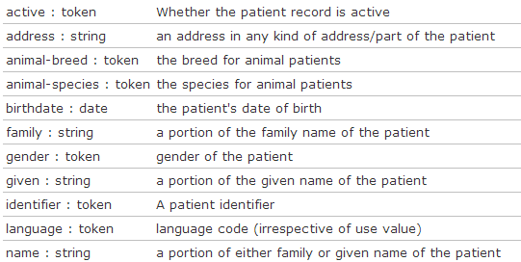
Search (patient)
Each resource has a set of “standard” search operations, so not every element can be searched (by default)!:
Our last search used this one

Slide 73
Combining parameters
Specifying multiple parameters finds resources matching all params ➔ “AND”
Parameters may list multiple values ➔ “OR”
Try:
https://server.org/fhir/Patient? birthdate=1972-11-30&language=nl,fr

Slide 74
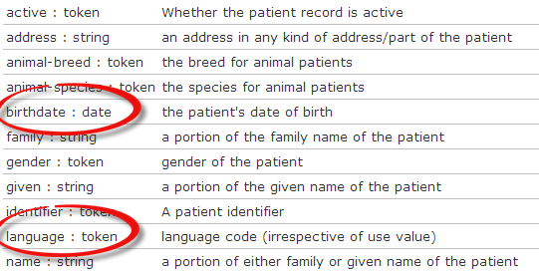
Search (patient)
Each search parameter has a ‘type’
Parameter
Type

Slide 75
Parameter types
number: =, =lt, =ge, =lt, =ge, =ne
Significant digits matter
date: =, =lt, =ge, =lt, =ge, =ne
Matches calculated using interval operations
Precision turns all dates into intervals
string: =
“starts-with” search, ignoring case, accents
Can use :contains for contains search or :exact to be case and accent-sensitive

Slide 76
Parameter types (cont’d)
token: =
[code] matches codes/identifier values independent of system
[system]|[code/value] matches a specified code or identifier within the specified system
|[code/value] matches the specified code or identifier in instances where no system is declared
:text performs a string search on CodeableConcept.text, Coding.display and Identifier.label
:in and :not-in allow filtering based on value sets

Slide 77
Parameter types (cont’d)
quantity: =, =lt, =gt, =le, =ge, =ne
[comparator][number]|[system]|[code]
Follows rules for number + token together for value + units of quantity
reference: =
Either the local or absolute id
:type filters resource type

Slide 78
Ok I get it…or not?
[base]/Patient 406 hits
[base]/Patient?gender=male 231 hits
[base]/Patient?gender=female 166 hits
[base]/Patient?gender=other 4 hits
[base]/Patient?gender=unknown 1 hits
Total: 231 + 166 + 4 + 1 = 402
[base]/Patient?gender:missing=true 4 hits
Total: 402 + 4 = 406

Slide 79
Chained searches
Patient has a search for “name”.
Observation has a search for “subject” (the id of the Patient, Group or Device)
How do I find Observations for a patient, searching using his name?

Slide 80
2 queries in 1
You (as a client) don’t need to do separate operations, just one:
https://server.com/fhir/Observation?
subject.name=jim
But note: this still only works on the predefined search parameters. You cannot just use any property of the resource.
Notes:
You can chain multiple levels deep – 2, 3, 4, more levels deep
This would search subject on any (Patient, Device, Group, Location).
If you want to limit to patient you can do an &subject:type=Patient

Slide 81
More optimizations
Say we do:
https://fhir.com/fhir/Observation?date=2014-01-20
We get back: a Bundle with 0..* “Observations”
Now, usually, wouldn’t we want the Patient information too? => Need to do “N” queries for the Observation’s “subject”
Quicker:
?_include=Observation.subject
Returns both Observations + Patients

Slide 82
Reverse Include
You can also do the reverse. E.g. Give me this patient and all the observations that point to them (careful – this could be a large set . . .)
Patient?_revinclude=Observation:subject

Slide 83
Composites
What if I want to find all groups with a characteristic of “eye color = green”
Group?characteristic=eye color&value=green
Result: instance with characteristics of “eye color=blue” and “favorite color=green”
Solution
Group:characteristic-value=eye color$green
(don’t forget to escape the blank . . .)
Notes:
Obviously not real codes

Slide 84
Extension parameters
Just as FHIR doesn’t define all possible data elements, we don’t all possible parameters
Extension search parameters defined using Profiles
Conformance Statements identify what extension parameters are supported and what they’re called

Slide 85
Sorting
Use _sort: to control sort
E.g. Observation?_sort:name,-date
Sorts observations of the same type together, newest first
Notes:
Search results are in no particular order unless you provide a sort order

Slide 86
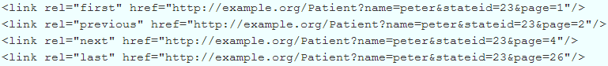
Paging
RFC 5005 defines a mechanism for paging a feed - we continue use it in Bundle
Keep in mind that paging can be tricky in a stateless environment
Result set can change
Don’t want to accidentally miss data when paging forward
Notes:
Consider adding a “most recent change timestamp” as part of the continuation so you can flag if changes impact result sets.
--
REST is stateless so folks could be adding and deleting data after your query. You could query and create a cached result set.
No predefined patterned for Continouation links – could be just GUIDs

Slide 87
Summary
Some resources can be “big”
e.g. Patient with pictures & lots of contacts
10MB JSON result set is bad when you’re an Android app presenting a list of 100 patients for a clinician to scroll through
Solution: _summary=true strips a resource’s elements down to those most likely to be useful in a “list” view.
Notes:
FHIR spec defines summary – not a server specific option

Slide 88
Compartments
Some system designs like to enforce security based on URL. For them
https://example.org/fhir/Patient/1/Observation
Is more useful than
https://example/fhir/Observation?subject=Patient/1
For that reason, FHIR allows Compartmenting by Patient, Practitioner, Organization and a few other resources where that is appropriate
Notes:
not strong use right now

Slide 89
Query by Tag
FHIR provides the ability to tag resources to identify profiles, access constraints, workflow, etc.
(We’ll discuss this more later)
In addition to normal query parameters, it’s also possible to query by tags applied to the resource
Notes:
Pull by profile or security label of something.

Slide 90
Get vs. Post
Query parameters can be sent either as part of the URL using a GET or as an application/x-www-form-urlencoded payload on a post
Some technologies may prefer one over the other. As well, POST hides query parameters from URL logging, which may provide privacy protections in some environments.
Notes:
Some folks have expressed concern about putting all the parameters in the URL. If you encrypt in TLS everything outside the port is secure, both the url and body. FHIR permits ability to put search parameters in the body.

Slide 91
Query interoperability
FHIR has a lot of query capability
However . . .
Almost all of it is optional
So how do you design a client when you have no clue what the server will support?
The more generic you want your client to be, the less you should rely on sophisticated server capabilities
Always check the response to see what parameters were actually used
Notes:
No server has support paging, chaining, filtering, etc. ALL OPTIONAL.
You could query for all and then process on client side, but that will let you interop with lots of folks, but be complex on client size and waste bandwidth since more is sent then needed. A client can determine what a server supports by using conformance resource – which confirms they are capable of
noSQL repository may make your head hurt.

Slide 92
Exercise #5
Answer some questions . . .
(30 minutes)
Notes:
Pick a few different servers…

Slide 93
Answer FHIR questions
Summary of all male patients born between 1960 and 1980
All patients whose organization is Health Level Seven
Most recent weight measurement
Patient van de Heuvel’s glucose readings over 6.2 g/dL
All patients with a confirmed condition of Asthma
Average blood pressure over the past year for patient smith
Notes:
Todo: real queries

Slide 94
FHIR Implementation Supports

Slide 95
The spec itself
The spec contains:
Validated examples
Descriptions, usage notes, constraints
Guidance for using paradigms
Guidance for interoperating with v2/v3/CDA
Be aware that when navigating by links, you may miss important information
So:
Before raising a question, make sure you’ve double-checked the spec ☺

Slide 96
Resources for developers
Where to get support:
http://chat.fhir.org
Stack Overflow
FHIR List server
gForge Tracker (Change requests)
FAQs (members only)
Test servers
http://wiki.hl7.org?title=FHIR

Slide 97
Other tools
Profile editors
Forge, Trifolia, others?
Validators
Java, C#
Questionnaire, Code System and ValueSet editor
Draft
IG Publisher
FHIR Registry

Slide 98
Reference implementations
Contents
Model – classes generated from the spec
Parsers – Parsers generated from the spec
Serializers – Serializers generated from the spec
FhirClient
Validation (currently Java only)
Java – Everything on the downloads page
.NET – NuGet “FHIR”, or GitHub “fhir-net-api”

Slide 99
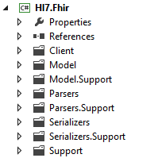
C# reference implementation
Download Csharp.zip from the Implementation page (source code + dll distribution):
Namespaces
Model – C# classes generated from the spec
Parsers – C# Parsers generated from the spec
Serializers – C# Serializers generated from the spec
Support
Client

Slide 100
A FHIR Resource in C#
public partial class Observation : Resource
{
// Codes that provide reliability information about an observation
public enum ObservationReliability {Ok, Ongoing, …}
// Codes identifying interpretations of observations
public enum ObservationInterpretation {N, A, L, H }
public CodeableConcept Name { get; set; }
public List<ObservationReferenceRangeComponent> ReferenceRange { get; set;}
public Code<Observation.ObservationReliability> Reliability { get; set; }
public ResourceReference Performer { get; set; }
}
Notes:
Enums are generated for coded types with required, fixed, valuesets
Nested classes are defined for each component in a Resource, all nested directly within the Resource
Cardinality > 1 => becomes a List<>
Cardinality 1 => Not expressed in model, but done in validation
All classes are partial so you can add code them in another code file (keeping generated+handcrafted code separate)

Slide 101
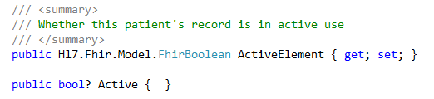
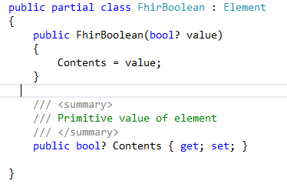
Primitives are not really primitive…

Slide 102
Parsing/Serializing using C#
ErrorList errors = new ErrorList();
// Create a file-based reader for Xml
XmlReader xr = XmlReader.Create(
new StreamReader(@"publish\observation-example.xml"));
// Parse the Observation from the stream
var obs = (Observation)FhirParser.ParseResource(xr, errors);
// Modify some fields of the observation
obs.Status = ObservationStatus.Amended;
obs.Value = new Quantity() { Value = 40, Units = "g" };
// Serialize the in-memory observation to Json
var jsonText = FhirSerializer.SerializeResourceToJson(obs);

Slide 103
Parsing/Serializing using Java
XmlParser xml = new XmlParser();
Observation obs = (Observation)xml.parse(new FileInputStream(“observation.xml"));
obs.setStatusSimple(ObservationStatus.amended);
Quantity newValue = new Quantity();
newValue.setValueSimple(new BigDecimal(40)); newValue.setUnitsSimple("g");
obs.setValue( newValue );
ByteArrayOutputStream bos = new ByteArrayOutputStream();
JsonComposer comp = new JsonComposer();
comp.compose(bos, obs, true);
String json = bos.toString("UTF8");

Slide 104
Using FHIR Client in C#
var client = new FhirClient(
new Uri("https://fhir.com/svc/fhir"));
// NB: patient is a ResourceEntry<Patient>, // not a Patient
var patEntry = client.Read<Patient>("1");
var pat = patEntry.Resource;
pat.Name.Add(HumanName.ForFamily("Kramer")
.WithGiven("Ewout"));
client.Update<Patient>(patEntry);

Slide 105
Using FHIR Client in Java
FHIRClient client = new FHIRSimpleClient();
client.initialize("https://spark.furore.com/fhir");
AtomEntry<Patient> pe = client.read(Patient.class, "1");
Patient p = pe.getResource();
HumanName hn = new HumanName();
hn.getFamily().add(Factory.newString_("Kramer"));
hn.getGiven().add(Factory.newString_("Ewout"));
p.getName().add(hn);
client.update(Patient.class, p, "1");

Slide 106
Profiled FHIR
Notes:
10:00

Slide 107
Profile-less FHIR
You don’t need profiles to interoperate with FHIR
Resources are “discrete” enough that mechanism to populate most elements is clear
Approach
Populate/consume all elements you know, use HL7 or country-standard extensions for extras
Map to/from “recommended” terminologies as much as possible, populate CodeableConcept.text
Expose capabilities in CapabilityStatement resource
Notes:
With profile, they can interoperate ‘ok’.

Slide 108
The need for Profiles
Many different contexts in healthcare, but a single set of Resources
Need to be able to describe restrictions based on use and context
Allow for these usage statements to:
Authored in a structured manner
Published in a repository
Used as the basis for validation, code, report and UI generation.

Slide 109
Profile Uses
Profiles are needed to
Define document and message boundaries
Define extensions
Set interoperability expectations in a particular context
National standards, types of care, business patterns
Publish clinical practice guidelines / detailed clinical models
Document system capabilities

Slide 110
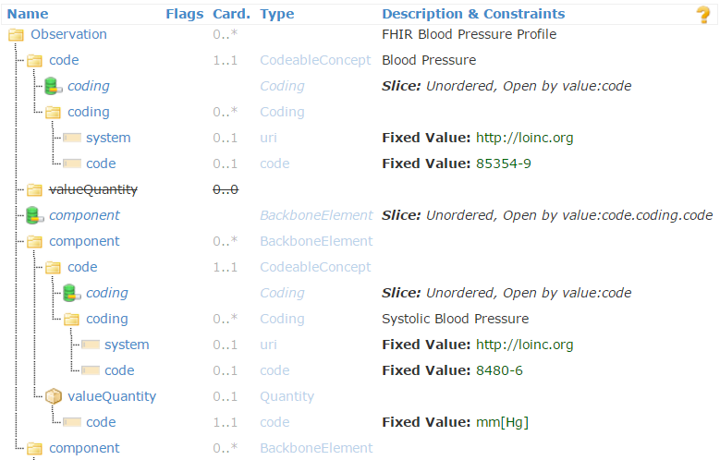
Profiled Observation (Blood Pressure)

Slide 111
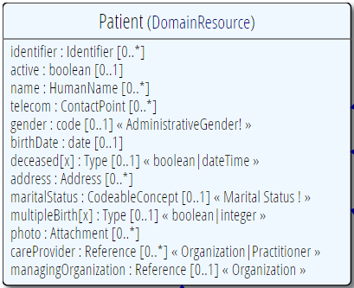
Profiling a resource
Demand that the identifier uses your national patient identifier
Limit names to just 1 (instead of 0..*)
Limit maritalStatus to another set of codes that extends the one from HL7 international
Add an extension to support “RaceCode”
Note: hardly any mandatory elements in the core spec!

Slide 112
Business Cases for FHIR

Slide 113

Mobile Friendly
RESTful interface & JSON support are “natural” for web-based solutions
APIs – including Swift make mobile solution easy
Resources are lightweight = faster response times
Documentation appeals to mobile developers, less learning curve

Slide 114
Context-free interfaces
RESTful interface is generic
No need to define message events or payloads
Query what you need
One interface can work for multiple partners & solve multiple communication needs
Extensions allow support for specialized needs
Business rules move from the interface to the access control layer
Faster/more dynamic configuration

Slide 115
Bulk data
Most healthcare interfaces are narrow in scope
Specific patient, specific encounter, specific event
FHIR supports querying whatever’s of interest
All of a patient’s record I’m allowed to see
All data for my patients
All data related to condition X across patients
Subscriptions allow data to be pushed

Slide 116
Profiling and Validation
Conformance artifacts in FHIR are defined computably and resolvable computably
Allows robust validation, including terminology
Support for automated testing of interfaces
Allows sharing of profiles, clinical practice guidelines
Allows dynamic configuration of application behavior and user interface

Slide 117
SMART on FHIR
Mobile Apps
Web Apps
OAuth2
REST API
MU-oriented FHIR Data Profiles
Underlying Health IT Systems
Your system here.

Slide 118
CDS Hooks

Slide 119
Documents that are easier
FHIR allows documents that are easier to use than CDA
Data can easily be consumed and used for other purposes
RESTful interface
Decision support
Etc.
Use documents for what they’re meant for, rather than everything

Slide 120
Leverage the Community
FHIR has attracted far greater attention and energy than any previous HL7 specification
Almost 8000 change requests
Up to 2500 chat.fhir.org messages/week
~180 FHIR-related sessions at San Diego WGM
Spawned university courses, open source projects, conferences, etc.
That energy attracts implementers and provides better support

Slide 121
Key payer drivers
Influence decisions at point of care
Greater efficiency, lower costs, value-add for clients
Improve data access
More timely (up to real-time or even pro-active)
Greater breadth – especially clinical data
Greater consistency
Lower cost/less negotiation
Notes:
Ensure medication reconciliation takes place

Slide 122
Additional insights
Furore Executive Videos series
http://fhir.furore.com/Education#videos
FHIR Applications Roundtable (Jul 2016)
https://www.pathlms.com/hl7/courses/3152

Slide 123
FHIR Features
And the architecture decisions that go with them
Notes:
10:00

Slide 124
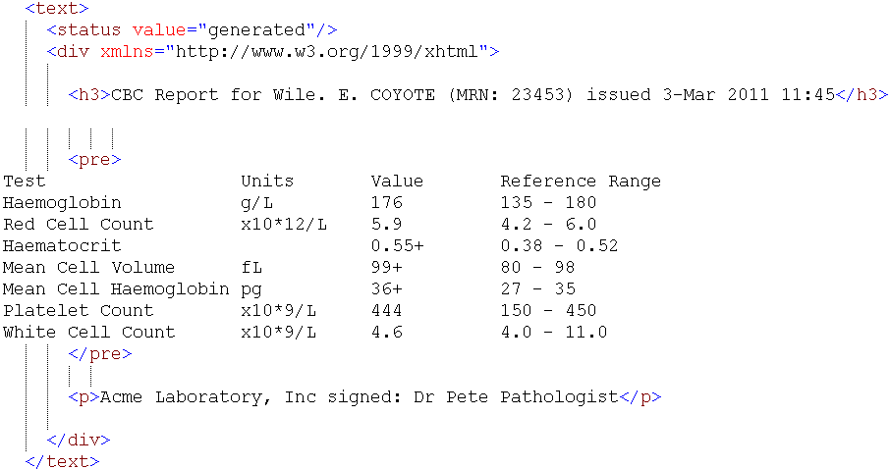
Narrative
Notes:
When should narrative be exposed
Should it be generated or manually entered?
What should it contain and what should it look like?
When received, should it be displayed?

Slide 125
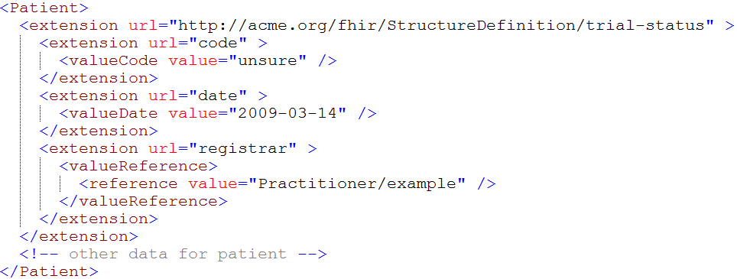
Extensions
Notes:
How do I handle extensions I don’t recognize? (rejection, display, persistence)
When should I include an extension?
Where should extensions be positioned?
Where should I register my extensions?
How can I handle modifier extensions?

Slide 126
Versions
33, v12 – 2012-12-04
/server.org/fhir/Patient/33/_history/12
33, v13 – 2012-12-05
/server.org/fhir/Patient/33/_history/13
33, v14 – 2012-12-08
/server.org/fhir/Patient/33/_history/14
33, v15 – 2012-12-09
/server.org/fhir/Patient/33/_history/15
/server.org/fhir/Patient/33
Notes:
What level of versioning support should I have?
What are ways to “fake-out” versioning support if the back-end doesn’t support that?

Slide 127
Tags
Patient
MRN 22234
“Ewout Kramer”
30-11-1972
Amsterdam
Tag: system: http://example.org/fhir/Status
code: Test
Profile: http://hl7.org/fhir/StructureDefinition/us-core
Notes:
What are tags for?
When do you use a tag rather than an extension?

Slide 128
Syntaxes
XML
JSON
<XXX xmlns=“urn:foo”>
<B a=“c” />
<C>One</C>
<C>Two</C>
<D>One</D>
<div>Not <b>so</b> easy</div>
</XXX>
{ “B”: { “a” : “c” },
“C”: [ “One”, “Two” ],
“D” : [ “One” ],
“div” : {
“text-before”:“Not ”,
“b”:“so”,
“text-after”:“easy”}
}
Notes:
How do I convert between the syntaxes, and why is that approach necessary?
What syntaxes should I support?
What syntax should be used when?

Slide 129
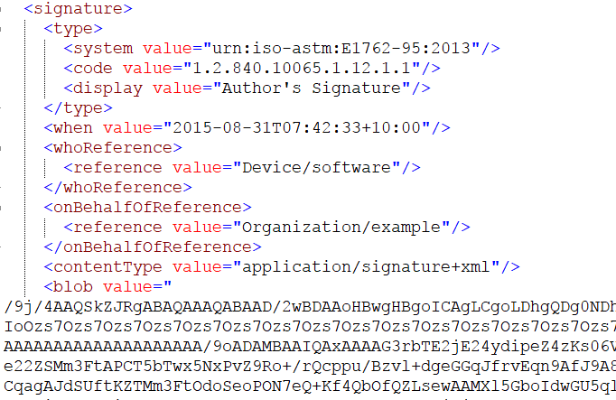
Digital signatures
Notes:
Where can signatures appear/what can be signed?
Are digital signatures necessary?
What steps are needed to retain signature validity when converting syntaxes or persisting data?

Slide 130
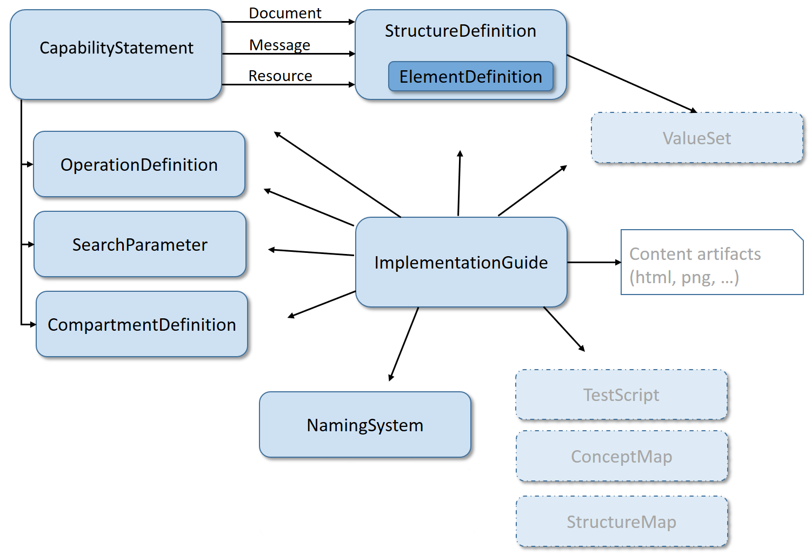
Conformance Resources
Notes:
What does it mean for FHIR to use FHIR to define itself?
How are the conformance resources used for dynamic configuration?
Where should they be hosted?
How will updates to higher levels cascaded down?

Slide 131
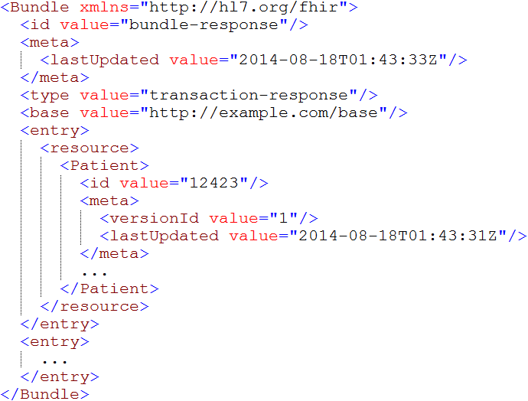
Bundles
Notes:
What are bundles used for?
How can elements within a bundle be identified?
Where can referenced resources appear?

Slide 132
What now?
Notes:
10:00

Slide 133
Dealing with STU
FHIR is a “standard for trial use”
Anything can change – no compatibility promised
Changes driven by implementation feedback
Most changes expected in resources
Already significant implementation experience through reference implementations, connectathons
Some needed resources aren’t yet defined
Outbreak, Public Health Case, etc.
Some content will (hopefully) become normative in FHIR R4 (2018), but most won’t
What goes normative when will depend on degree of implementation

Slide 134
STU Strategies
If multiple STU versions could be in play
Distinguish using extensions or distinct endpoints
Be prepared to transform between versions to move/rename elements or handle syntax changes
For missing resources
Use Basic
Create your own custom resource
Non-conformant, but ok during STU in closed community

Slide 135

Estimating
How much will implementing a FHIR solution cost?
Considerations
Reference implementations help
Learning curve is lower
Still a curve if unfamiliar with XML / JSON / REST
Faster to “drive by” interoperability
Can’t speed consensus
Tools to help with mapping to internal codes and structures, still takes time
Anecdotal is “faster” to “significantly faster” to implement
Notes:
If I had a guaranteed answer, I’d be too busy to teach this course . . .

Slide 136
Skill requirements
To implement a FHIR solution, you’ll need:
Knowledge of XML and/or JSON
Some degree of familiarity with HTTP (assuming REST)
Likely someone knowledgeable in HTTP security and possibly OAuth

Slide 137
Considerations
What’s giving you pain now?
How could FHIR address those pain points?
What new opportunities does FHIR offer?
What worries you about using FHIR?

Slide 138
Time-points for re-evaluation
Q4 2018: FHIR R4 published
with some normative content?
Additional releases every 18-24 months

Slide 139
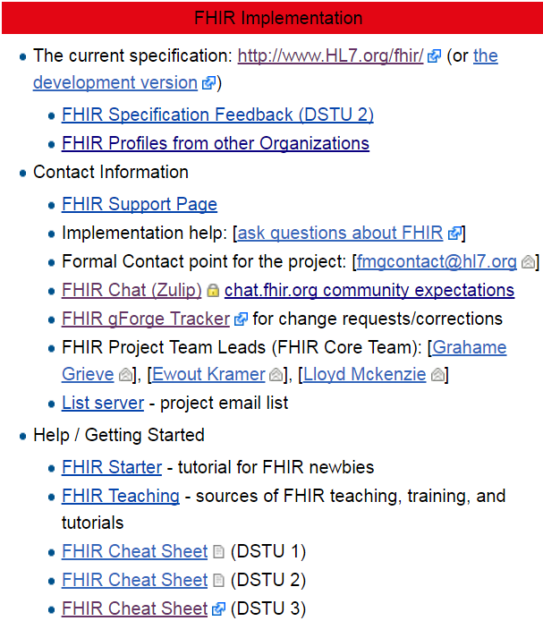
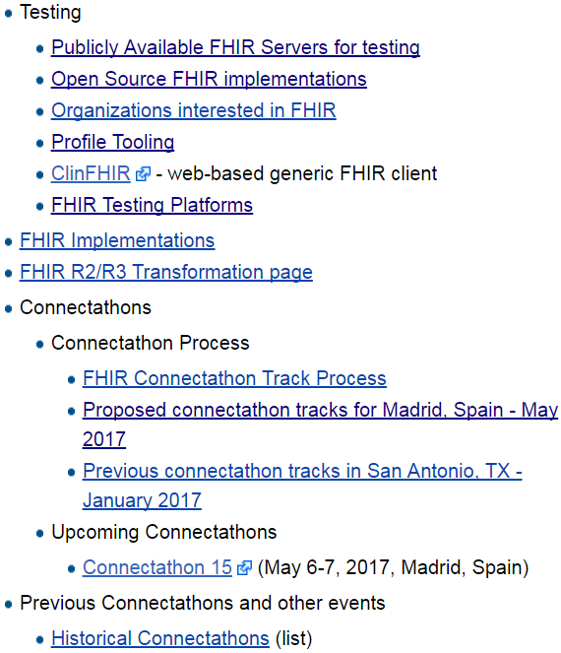
Resources wiki.hl7.org/?title=FHIR

Slide 140

Next Steps for you
Attend other FHIR tutorials
Developers, Profiles, Deep Dive
Read the spec: http://hl7.org/fhir
Join http://chat.fhir.org
Follow #FHIR on Twitter
Shape the specification:
Join the FHIR track at this WGM
Feedback – chat, tracker, list server
Try implementing it
Come to a Connectathon!

Slide 141
Education opportunities
Attend a Working Group Meeting
Tutorials, Connectathons
Jan 26-Feb 2 New Orleans
May 11-18 Cologne
Sept 28-Oct 5 Baltimore
FHIR Institute Webinars
Dec 1-5
2018 Schedule TBD
Custom education available

Slide 142






International HL7 FHIR Developer Days November 15-17, 2017 in Amsterdam
(And for the first time in the U.S.: June 19-21, 2018)
Education
34 speakers
70+ tutorials/presentations
5 tracks
Connectathon
Meet fellow developers
Put FHIR to the test
Networking
FHIR experts and authors on hand
http://fhir.furore.com/devdays

Slide 143

Show Us Your Apps!
Dec 5 – 6, New Orleans, LA
15 minute presentation of your functioning FHIR app
Deadline: October 15, 2017
http://bit.ly/presentfhir

Slide 144

Questions?
http://hl7.org/fhir lmckenzie@gevityinc.com

